Slide 1
CMP5308: Advanced Programming UG2
Develping a
Text Message Server in Java
A Client/Server internet Utility Tool

Slide 2
Group_E5
Group Members:
Callum Jack Melrose,
Benjamin Stephen Long,
Evi Nikolaidou
Muhammad Awais

Slide 3
Get All Messages command

Slide 4
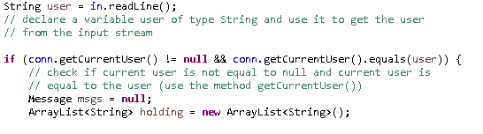
Username check and initialising array
In this code the username is entered by the user. The program then checks if the current user matches the username entered. If the it does an array list is created called ‘holding’.

Slide 5
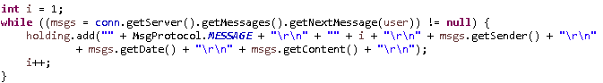
Getting the messages into the array
The variable ‘i’ is initialised as 1. While there are messages available for the user they are added to the array along with the number of the message (i), the sender and the date.
I is incremented by 1 after each message.

Slide 6
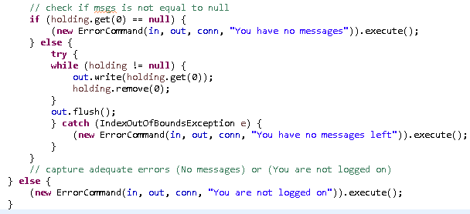
Outputting the messages pt.1
The code then checks if the array has anything in it. If it doesn’t then the error message ‘you have no messages’ is displayed

Slide 7
Outputting the messages pt.2
If messages are available then a while statement occurs – executing when the array isn’t empty. It will then output the first item in the array before removing it. This process will repeat until nothing is left in the array.

Slide 8
Outputting the messages pt.3
The program will then state when there are no messages left. At the bottom it can also be seen the error message that occurs if the username entered at the start is incorrect.

Slide 9
Registration
Two classes:
RegistrationCommand
RegistrationUpdate

Slide 10
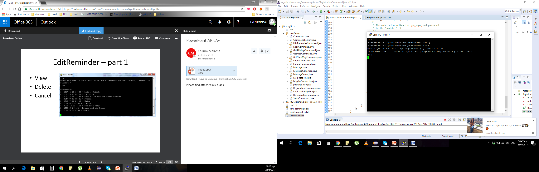
RegistrationCommand-part 1
To create a new account:
Username
Password

Slide 11
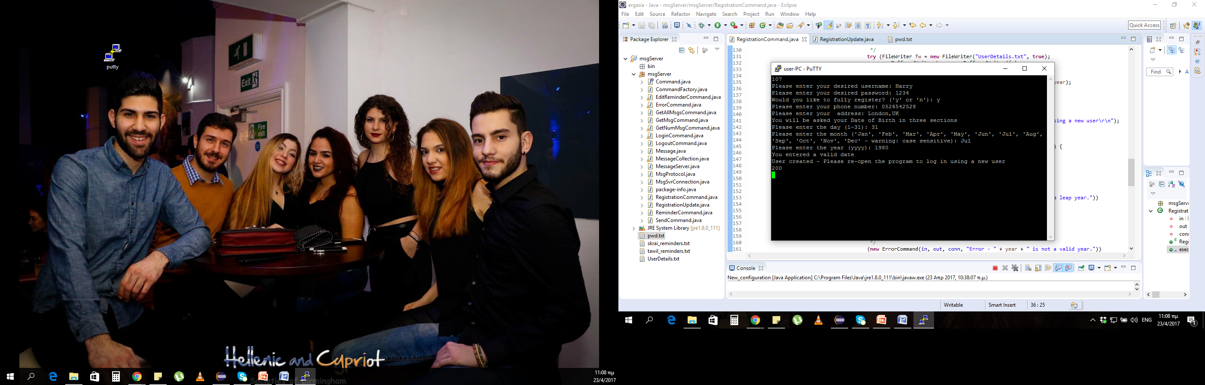
RegistrationCommand-part 2

Slide 12
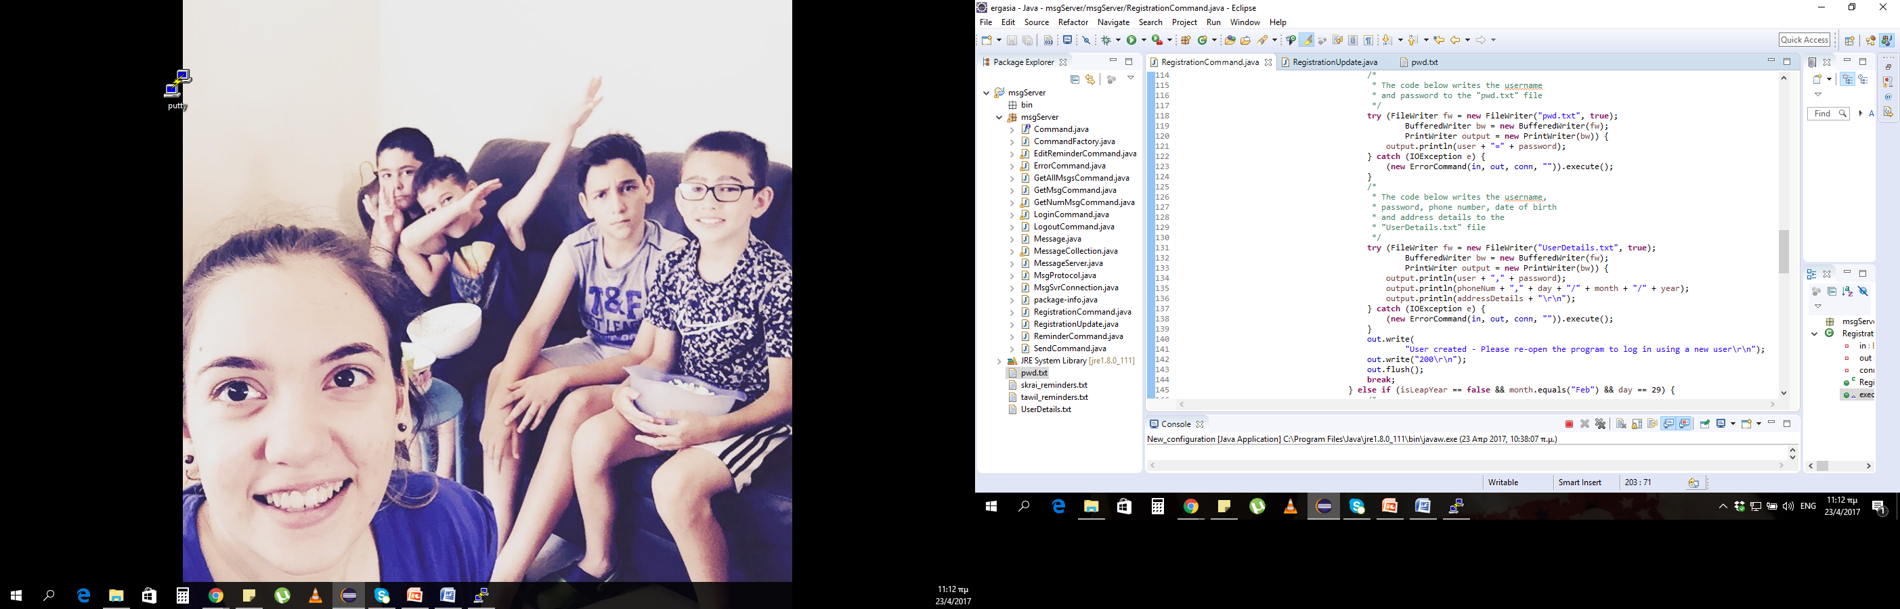

Slide 13
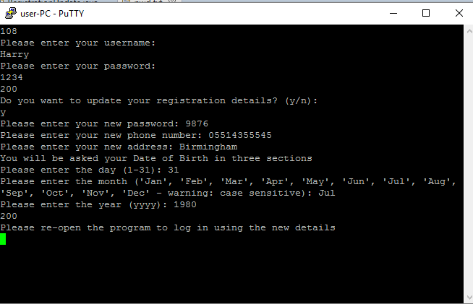
RegistrationUpdate-part 1

Slide 14
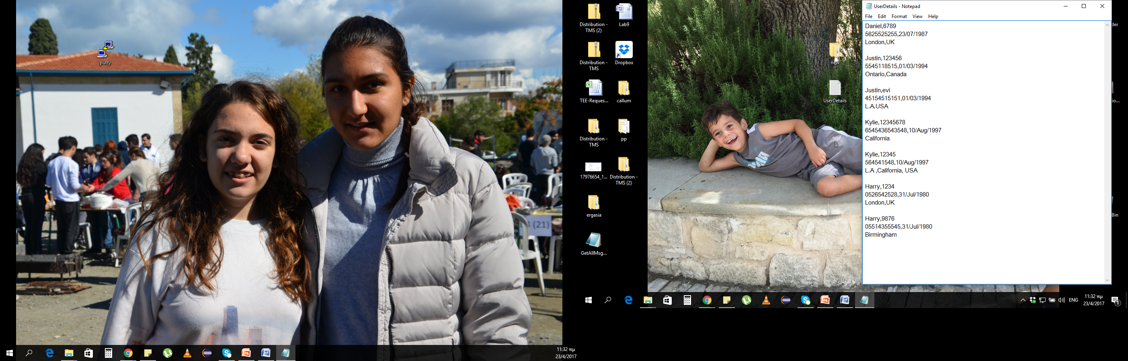
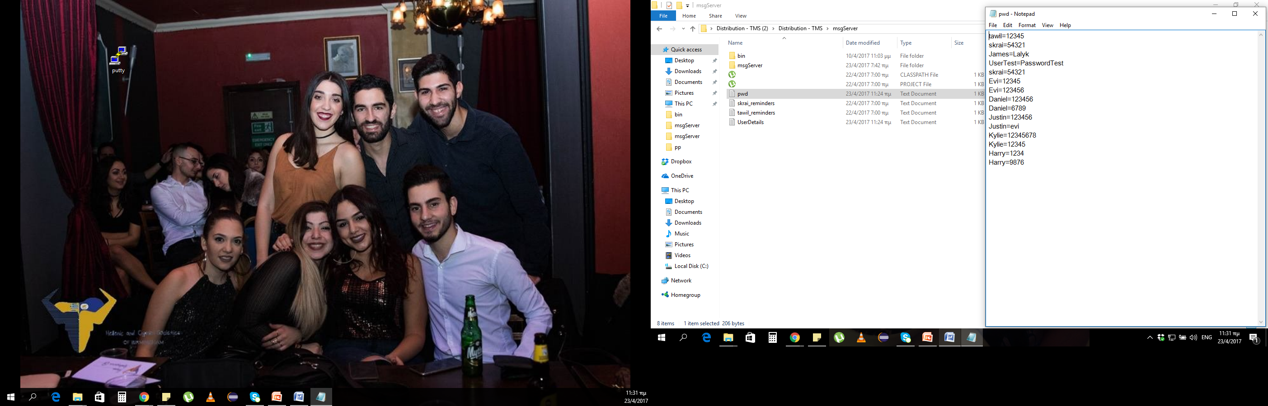
RegistrationUpdate-part2

Slide 15
Reminders
Three classes:
Reminder Command
EditReminder
TimerTest

Slide 16
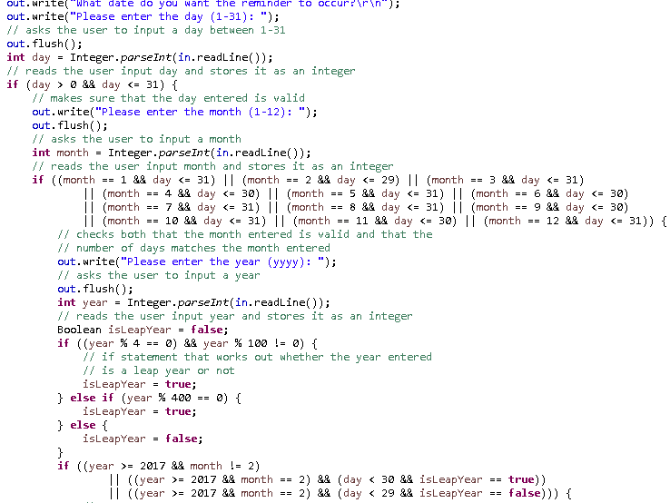
ReminderCommand – part 1

Slide 17
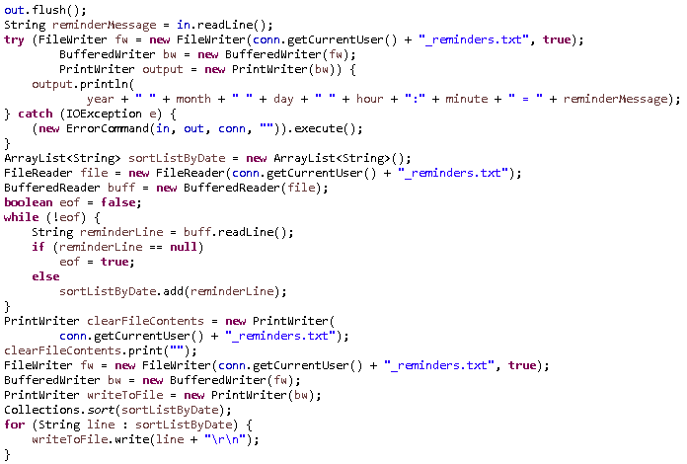
ReminderCommand – part 2

Slide 18
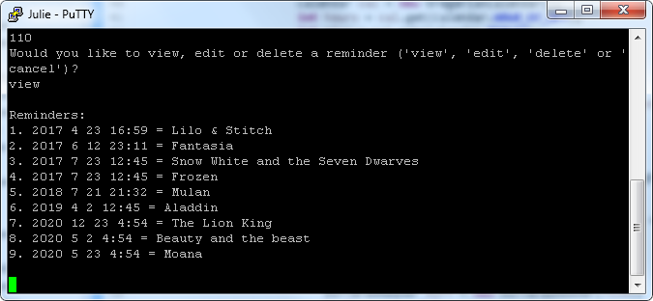
EditReminder – part 1
View
Delete
Cancel

Slide 19
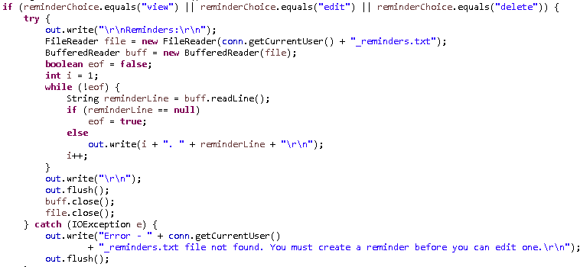
EditReminder – part 2
Edit:
Time
Date
Message

Slide 20
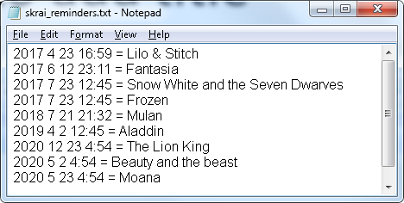
username_reminders.txt

Slide 21
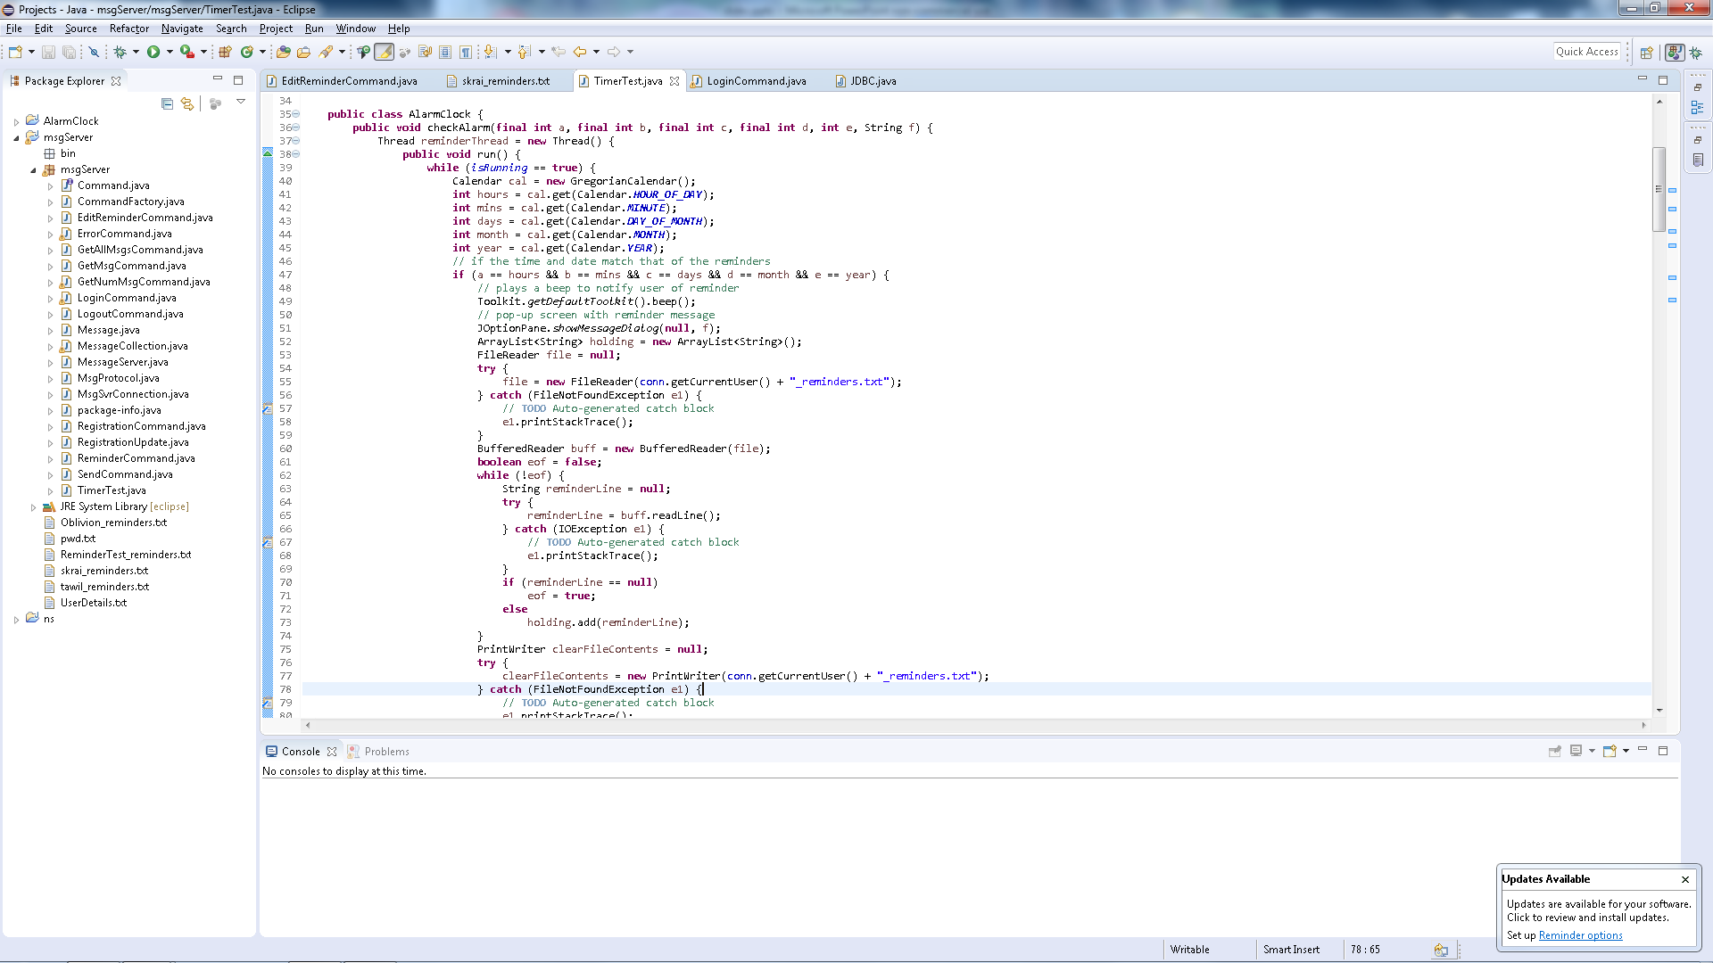
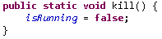
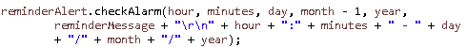
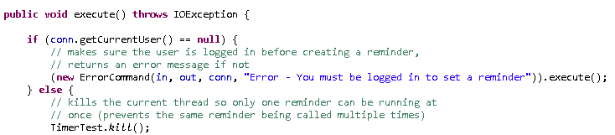
TimerTest – part 1
1
2
3
4

Slide 22
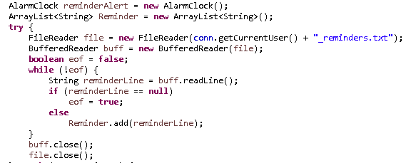
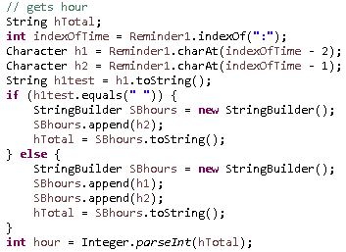
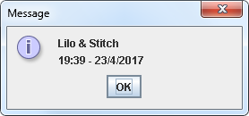
TimerTest – part 2
1
3
2

Slide 23
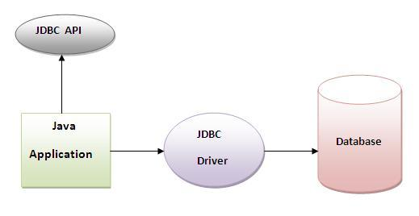
What is JDBC?
JDBC allows Java applications to connect to relational databases.
The JDBC driver provides the connection to a database.
Development process
Notes:
Development process:
Loading the JDBC driver to be able to connect to the database you wish
Provide the details of the database (name ,location) to enable a connection
Create a statement
Execute SQL query
Process the result set
Then close the connection, statement and result set objects

Slide 24
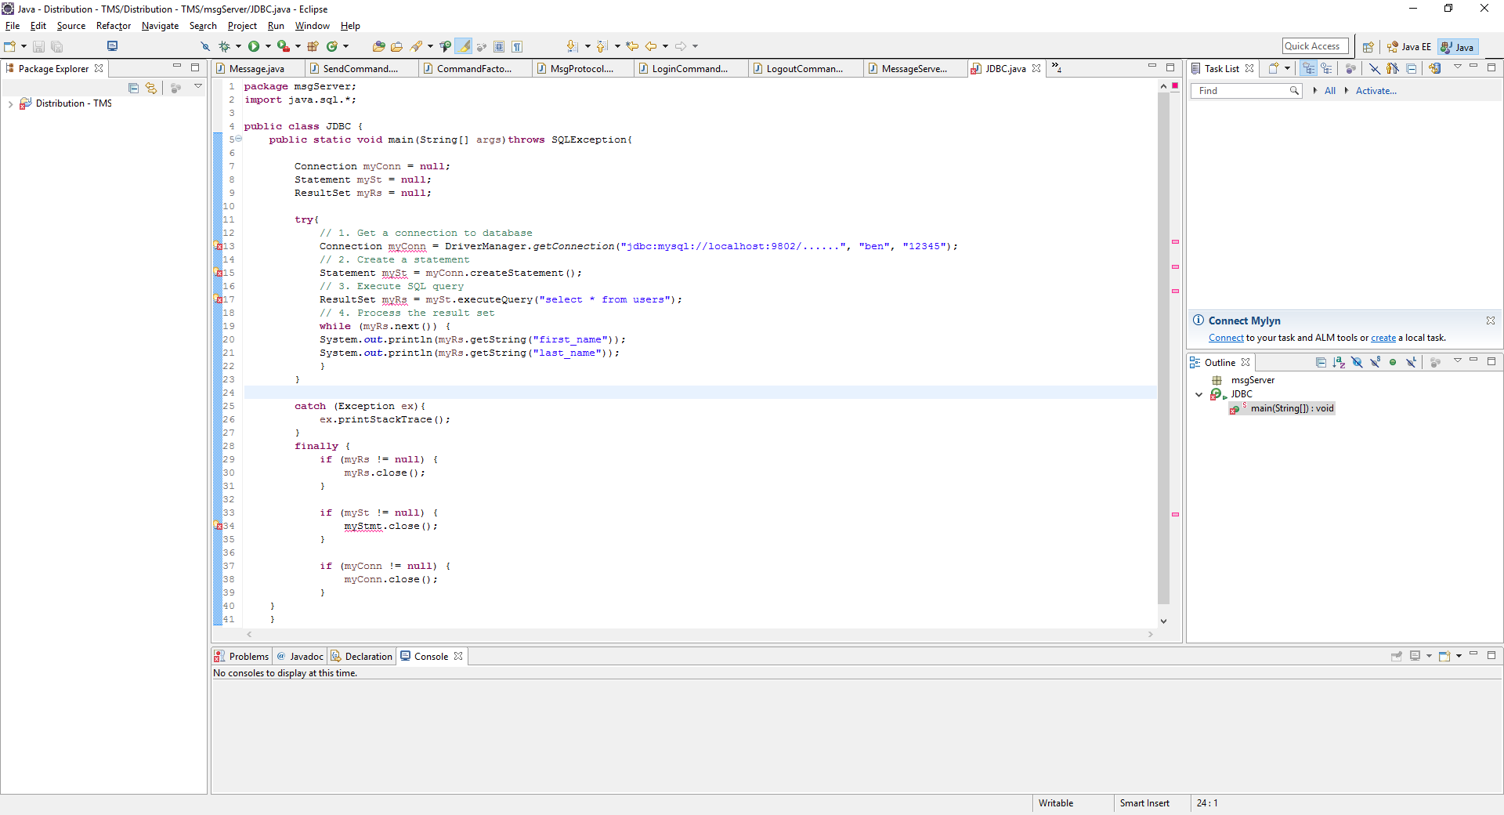
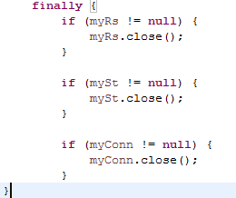
JDBC
java.sql.*
Connection
Statement
Execute SQL query
Processing ResultSet
Closing (ResultSet, Statement and
Connection).
Notes:
The first thing we need for JDBC is to import java.sql.* which provides the API for accessing and processing data stored in a data source.
Connection: A connection (session) with a specific database. SQL statements are executed and results are returned within the context of a connection.
Statement: The object used for executing a static SQL statement and returning the results it produces. We will use this in the next part.
Execute SQL query: A table of data representing a database Result Set. Here we are using a statement object to execute an SQL query. In this example we are selecting all from users to return a Result Set based on this.
Processing Result Set: The result set is initially placed before the first row so we use myRs.next to move forward rows and this returns true if there are rows to process.
Therefore we can use this to process each row in the result set. In this example we are getting data held in the first name and last name columns within the table.
Finally we close ResultSet, statement and connection.

Slide 25
Thank you!
ANY QUESTIONS?

